Slide 1
What are the Driving Factors of Legal Emigration in Kosovo and what Consequences can the Country Face from Growing Emigration Trends?
Tringa Tërmkolli

Slide 2

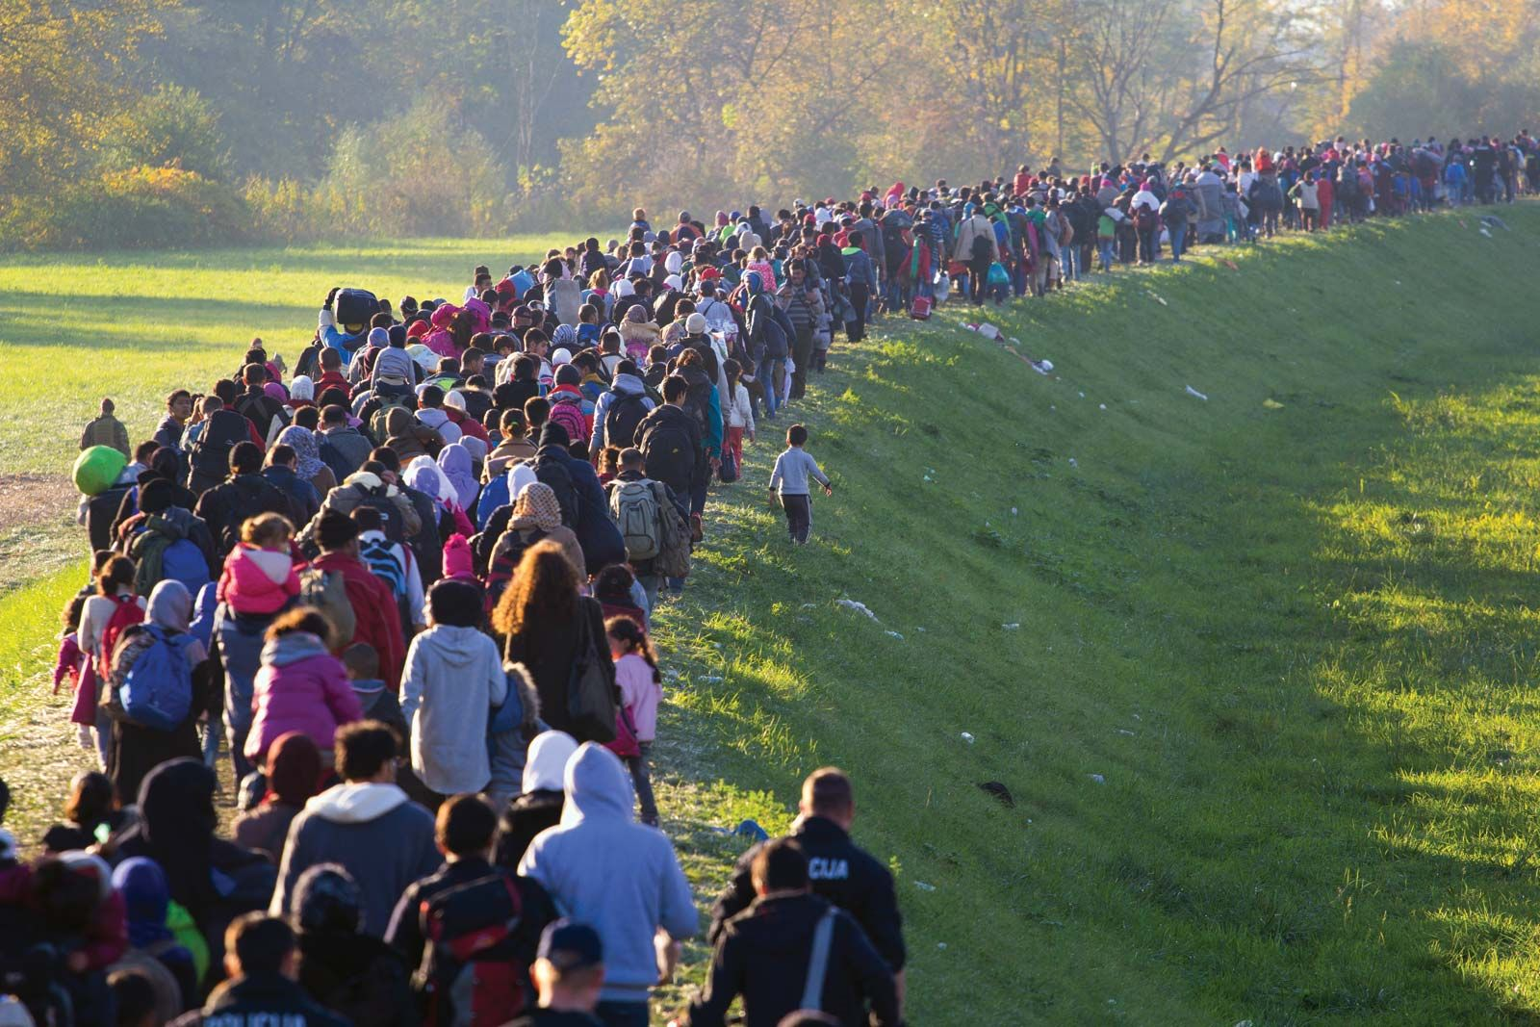
Introduction
Migration as a historical process:
Migration has existed since ancient times.
Human society has populated the entire globe through
migrations.
Emigration trends in Kosovo:
High level of emigration since the end of the last war.
Emigration can be legal or illegal.
Research objectives:
Examine the issues of growing emigration trends in
Kosovo
Analyze factors contributing to high growth of
emigration.
Address consequences of increased legal emigration.
Predict future growth trends in emigration.

Slide 3
Methodology
Research methodology:
  Reliance on secondary sources.
  Qualitative and quantitative methods.
  Implementation of description and analysis, as well as comparative methods.
  Review of scientific sources from local and international literature on migration.
  Analysis of official documents, reports, research, and credible organizations' analyses.
Parts of the Research
Definition of Migration
Methodology
Causes of Emigration – Push and Pull Factors
Conclusion
Reference
Characteristics of Emigration in Kosovo

Slide 4
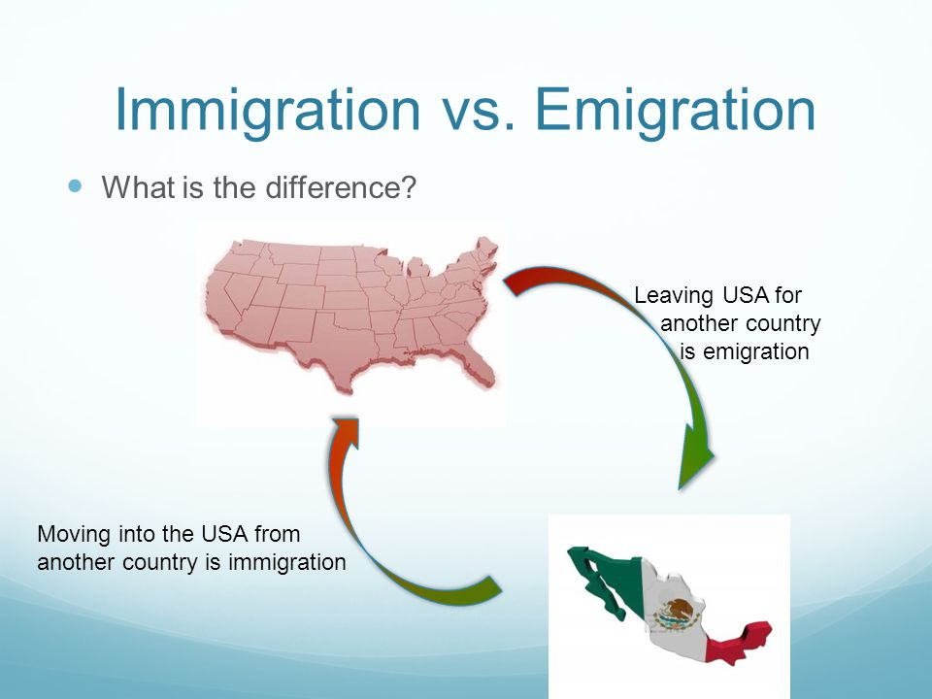
Definition of Migration
Migration involves the movement of people within a country or across country borders.
Migration is a historical process
International migration "The movement of individuals who depart from their country of origin or habitual residence to settle permanently or temporarily in another country.“
Latin
“migratio”
English
“migration”

Slide 5
Causes of Emigration - Factors
  Economic reasons: dire economic situation, search for work, higher wages.
  Family reasons: joining family members.
  Educational reasons: migration for studying purposes.
  Conflict and persecution: forced migration due to conflict, persecution, or human rights violations.
  Environmental factors: migration prompted by natural disasters or environmental conditions.
Push factors:
poverty
low wages
high unemployment
corruption
nepotism
low education levels
low healthcare
Pull factors:
higher wages
job opportunities
better education
good healthcare
higher standard of living

Slide 7
Migration Trends in Kosovo
Historical context of emigration in Kosovo:
  Kosovo has experienced significant emigration flows throughout the 20th and 21st centuries.
  Rural poverty in the 60s and 70s and political pressure in the 80s contributed to emigration.
  The war in 1998-1999 resulted in the expulsion of around 1 million Kosovars, but many returned after the conflict.
Emigration statistics and destinations:
  The estimated number of emigrants from Kosovo between 1969 and 2011 is around 703,978 inhabitants.
  As of the end of 2020, the estimated number of emigrants is around 885,862 inhabitants.
7%
15%
23%
7%
39%
7%

Slide 8
Migration Trends in Kosovo - Continued
In 2015 in Kosovo there was a increase of illegal emigration around 122,000.
Youth and unemployment:
  Kosovo has the youngest population in Europe, with an average age of 30.2 years.
  High unemployment rates, particularly among young people, with an estimated rate of 49.1% for those aged 15-24 in 2021.
  Unemployment, low wages, poor working conditions, and lack of contracts in the private sector contribute to emigration.
Impact of COVID-19 and economic challenges:
  COVID-19 and the war in Ukraine have worsened the situation in Kosovo.
  Increased prices and economic difficulties have affected family economies.
  Government measures for financial support have not fully addressed the citizens' problems.

Slide 9
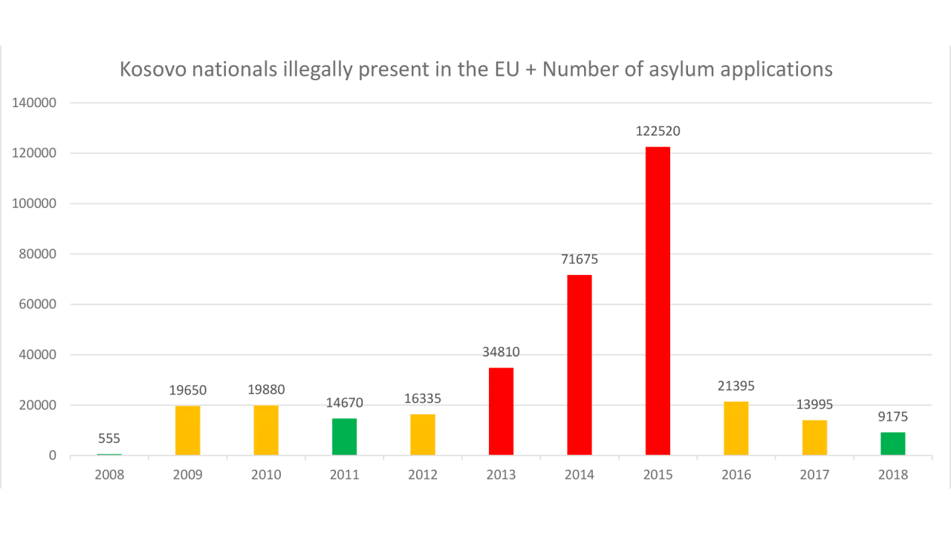

Slide 10
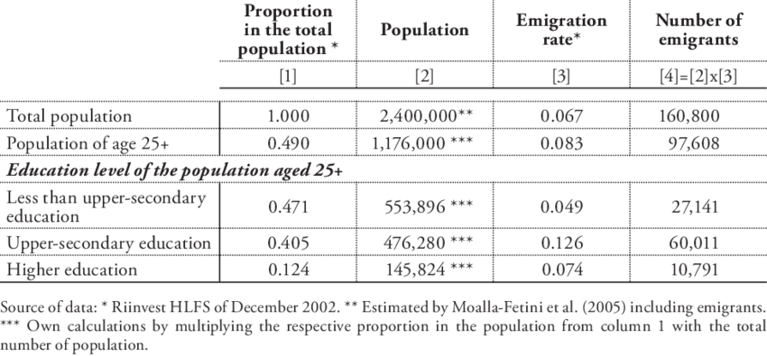
Brain Drain
"Brain Drain" phenomenon: The intensification of legal emigration of young and highly educated people, leading to a loss of skilled workforce.
Impact on the health sector: Emigration of doctors and nurses to EU countries, especially Germany, due to better working conditions and higher salaries.
Disturbing statistics: According to the Chamber of Doctors of Kosovo, 666 doctors left Kosovo from 2018 to October 2022. The Chamber of Nurses reported over 600 nurses leaving in 2022 alone.
Expected intensification of emigration in the medical field: The German 'Qualified Immigration Law' for non-European citizens, in force since March 2020, may contribute to further emigration of medical personnel.
Doctor’s salary
In Germany
4000 Euro
In Kosovo
630 Euro

Slide 11
Possible Trends of Emigration Growth in the Future
Continuous growth in emigration trends from Kosovo, indicating a concerning issue.
Research findings by Democracy for Development (DAD): 60% of Kosovars would leave the country if given the opportunity.
Higher inclination to emigrate among young people (81.6%) compared to other age groups.
Education level and emigration: Students have the highest inclination to leave at 81.4%.
Permanent emigration: Around 44.2% of young people expressed the intention to leave permanently.
Increasing number of work visa applications: In December 2021 and January 2022 alone, over 120,000 Kosovo citizens applied for work visas in EU countries such as Germany, Switzerland, and Croatia.
Anticipated increase in emigration: The statistics indicate a growing trend in emigration and suggest that the number of departures is expected to increase in the future.

Slide 12
Consequences of the High Rate of Rmigration
Proper policies and institutional support are lacking in Kosovo to effectively manage the positive aspects of emigration.
Remittances play important role in the country's economy, but excessive emigration can lead to problems.
Emigration can contribute to development in both the origin and destination countries, but the negative effects are often greater in the origin countries.
Consequences of high emigration in Kosovo: loss of labor force, brain drain, and population decline.
Decrease in population: According to the 2021 report of the Statistics Agency of Kosovo, the population of Kosovo has decreased by -24,215 inhabitants.
Lack of workforce: Many businesses, particularly in the construction and gastronomy sectors, face difficulties due to the shortage of staff.
Consequences for the health system: The flight of medical personnel poses serious challenges to the healthcare system, and there is a risk of potential collapse if the trend continues.

Slide 13
Conclusion
Kosovo is experiencing high emigration trends since the end of the recent war.
Statistics and surveys indicate a continued desire to emigrate, suggesting that emigration will likely persist in the future.
Urgent measures need to be taken by the government to address the issue.
Incentivizing young people to stay and creating new job opportunities are crucial in preventing the emigration of the younger generations.

Slide 14
Reference
Dubey, S., & Mallah, V. (2015), Migration: causes and effects. The Business & Management Review, fq 228, https://cberuk.com/cdn/conference_proceedings/2015iciee_india39.pdf
Simpson, N.B. (2017) , Demographic and economic determinants of migration: Push and pull factors drive the decision to stay or move, IZA World of Labor, fq.3 https://www.econstor.eu/bitstream/10419/171181/1/iza-wol-373.pdf
Gazeta Express (2022) https://www.gazetaexpress.com/ikja-e-mjekeve-a-do-te-shkoje-edhe-kosova-rruges-se-shqiperise per-tua-bllokuar-diplomat/
Democracy for Development (DAD), 2020, “ Mobiliteti i fuqisë Punëtore”, fq 20 https://d4d-ks.org/wp-content/uploads/2020/06/D4D_Mobiliteti-i-Fuqise-Punetore_SHQ.pdf
Monitor.al https://www.monitor.al/vetem-per-dy-muaj-mbi-120-mije-qytetare-te-kosoves-aplikojne-per-viza-te-punes/

Slide 15
Reference - Continued
Strategjia për Migrim 2021-2025, Republika e Kosovës, fq 11 https://mpb.rksgov.net/Uploads/Documents/Pdf/AL/378/Strategjia-e-Migrimit-2021-2025.pdf
Democracy for Development (2022), Rini aktive për zhvillim të Qëndrueshëm fq 4 https://d4d-ks.org/wp-content/uploads/2022/05/D4D_PolicyBrief_Rinia_04_SHQ_web.pdf
UNDP (2020 )“ Correlation Between Labour Market in Kosovo and out Migration” https://www.undp.org/kosovo/publications/public-pulse-analysis-correlation-between-labour-market-kosovo-and-out-migration
Behrami Sami, Kosovasot, - Kosova Sot (kosova-sot.info)
Agjencia e Statistikave të Kosovës ( 2021), Vlerësimi i Popullsisë, fq 10, https://ask.rks-gov.net/media/6873/vlersimi-i-popullesise-ne-kosove-2021-final.pdf

